Slide 1
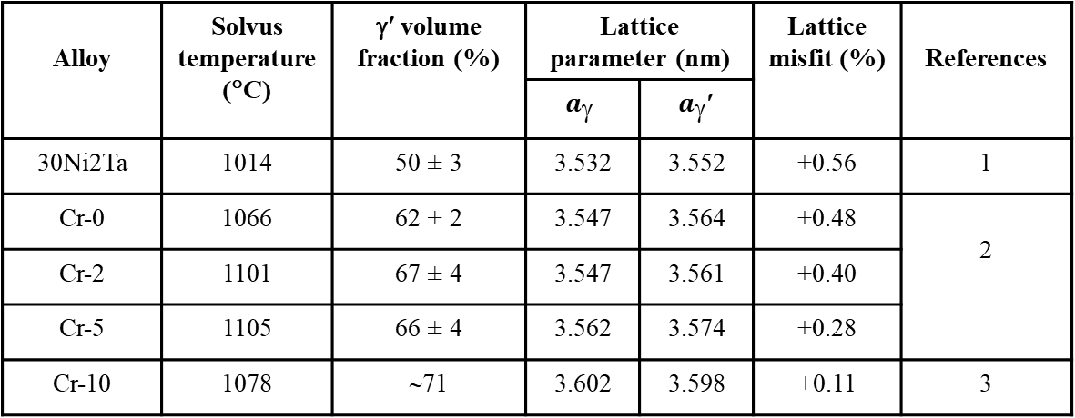
Table S1. Solvus temperature, γ’ volume fraction (%), lattice parameter of γ and γ’ phases, and lattice parameter mismatch of 30Ni2Ta, Cr-0, Cr-2, Cr-5, and Cr-10 superalloys aged at 900 ºC for 50 hours.
Alloy | Solvus temperature (°C) | γ′ volume fraction (%) | Lattice parameter (nm) |  | Lattice misfit (%) | References
 |  |  | $$a_{}$$ | $a_{}$′
30Ni2Ta | 1014 | 50 ± 3 | 3.532 | 3.552 | +0.56 | 1
Cr-0 | 1066 | 62 ± 2 | 3.547 | 3.564 | +0.48 | 2
Cr-2 | 1101 | 67 ± 4 | 3.547 | 3.561 | +0.40
Cr-5 | 1105 | 66 ± 4 | 3.562 | 3.574 | +0.28
Cr-10 | 1078 | ∼71 | 3.602 | 3.598 | +0.11 | 3

Slide 2
Figure S1. X-ray diffraction peaks of (200) planes for Cr-10 alloy. Peak fitting using pseudo-Voigt function shows two peaks corresponding to phases. The experimental details of the XRD is available in ref. [1]
Cr-10
 | 2θ (ψ-54.74) |  | Lattice Parameter |  | % Lattice Misfit
CHI-54.74° | γ' | γ | a_{γ'} | a_{γ} | _{+0.11}
 | 50.64 | 50.70 | 3.602 | 3.598

