Slide 1
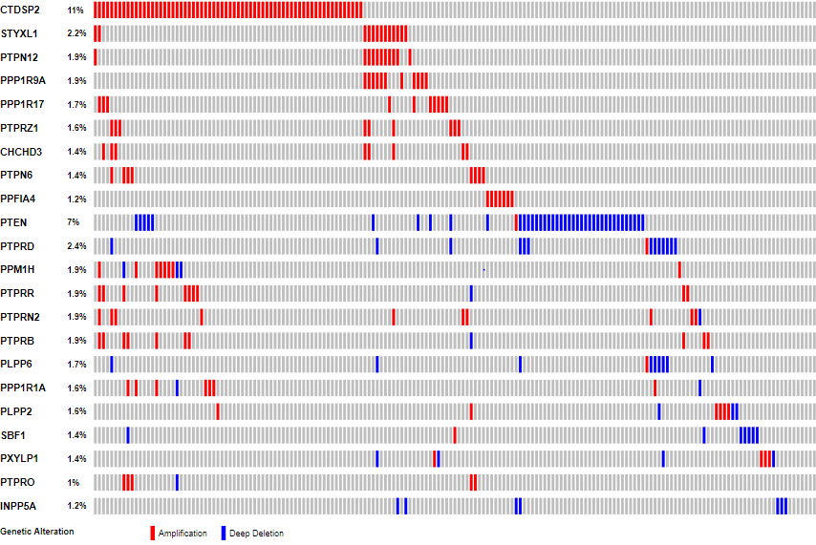
A
Gene
%
samples
B
Supplementary Figure 2; Tomar et al., 2019
CTDSP2
11.0
Control
GBM
STYXL1
2.2
Hypomethylated
CpGs (n=14)
PTPN12
1.9
PPP1R9A
1.9
PPP1R17
1.7
PTPRZ1
1.6
CHCHD3
1.4
Hypermethylated
CpGs (n=29)
PTPN6
1.4
PPFIA4
1.2
PTEN
7.0
PTPRD
2.4
PPM1H
1.9
-0.5 0.5
PTPRR
1.9
PTPRN2
1.9
Control
GBM
PTPRB
1.9
PLPP6
1.7
Upregulated
genes (n=10)
PPP1R1A
1.6
PLPP2
1.6
SBF1
1.4
PXYLP1
1.4
PTPRO
1.0
INPP5A
1.2
Amplification
Deep deletion
Downregulated
genes (n=12)
Genetic alteration
C
Control
GBM
-3.0 2.0
Hypomethylated
CpGs (n=14)
E
Downregulated miRNAs (n=9)
F
Upregulated miRNAs (n=5)
GSE79122
hsa-miR-299-5p
hsa-miR-485-5p
hsa-miR-769-5p
hsa-miR-409-3p
hsa-miR-485-3p
hsa-miR-324-5p
hsa-miR-142-5p
hsa-miR-142-3p
hsa-miR-17-3p
hsa-miR-30a-5p
hsa-miR-17-5p
hsa-miR-137
hsa-miR-133b
hsa-miR-107
Hypermethylated
CpGs (n=29)
upregulated phosphatases (n=33)
Downregulated phosphatases (n=61)
0.0 0.75
D
Control
GBM
Hypomethylated
CpGs (n=14)
GSE60274
Hypermethylated
CpGs (n=29)
0.0 0.75
Notes:
Figure 1: Flow chart depicting the use of various datasets to identify phosphatases important for glioma development and progression. Phosphatases (n=403) from 3 different publically available databases namely HuPhO, EKPD and DEPOD were used for this study. The first branch depicts the use of TCGA WES dataset to identify the mutated phosphatases, the possible effect of mutation on protein function and survival of patients. The second and third branch depicts the use of TCGA dataset to identify differentially expressed phosphatases in GBM followed by the possible causes of their differential regulation and survival analysis respectively. The fourth branch depicts the use of TGCA data to identify the transformation and aggressiveness related phosphatases in IDH1 wild type and mutant samples. The last branch identifies the GSC specific phosphatases. The number in brackets shows the number of samples used for analysis. GSC: glioma-like stem cells, NSC: normal neural stem cells, DGC: Differentiated glioma stem cells, HuPhO: human phosphatase portal, EKPD: Database of eukaryotic protein kinases and protein phosphatases, DEPOD: human dephosphorylation database.

