Slide 1
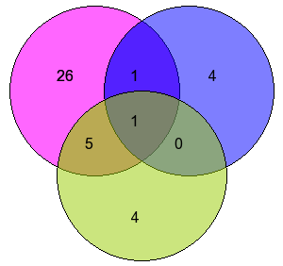
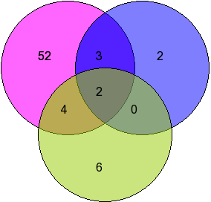
Supplementary Figure 3; Tomar et al., 2019
A
Upregulated Phosphatases
B
Downregulated Phosphatases
miRNA: Downregulated
miRNAs
CNV: Amplification
miRNA: Upregulated
miRNAs
CNV: Deletion
Methylation: Hypomethylation
Methylation: Hypermethylation
Notes:
Supplementary Figure 3: Probable causes of differential expression of phosphatases (A) Heat map showing the methylation pattern of probes corresponding to differentially expressed phosphatases that had differential methylation in GBM samples using GSE79122 for methylation analysis. (B) Heat map showing the methylation pattern of probes corresponding to differentially expressed phosphatases that had differential methylation in GBM samples using GSE60274 for methylation analysis.

